Slide 1
NCDF Data Lake Architecture Tiger Team
Jan 20 Working Session
Chuck Turnitsa
GTRI

Slide 2
Agenda for Jan 2023 Architecture TT meeting
Changes in TT membership/leadership
Review state of CWIX2023 Architecture prep
Review requirements for CWIX2023 Architecture Conceptual Model
Discuss establishment of architecture repository (TIDEpedia? GITHub?)

Slide 3
Change in Architecture TT Membership/Leadership
Introduce Pam Dargan, USA Architecture team support
Pam introduction – FMN work, Architecture, NAF and Archimate, etc.
Charles Turnitsa to stand down as main US Architecture team support, Stand down as leadership, end of January
New leadership should be selected from one of the participating nations; TBD at 31st DMCaT (Feb/March 2023)

Slide 4
Requirements for CWIX 2023 – from NCDF Tiger Team
Review of Requirements for CWIX 2023
What needs to be done – complete conceptual model, begin external architecture model, look at possible internal modeling opportunities
Develop a standard repository (NSF GIThub?)

Slide 5
CWIX 2023 conceptual model reqt’s and objectives(1/3)
Based on Oct2022 CWIX2023 requirements
Conceptual model should show external architecture of data lake, capturing elements that will be part of the Spiral 5 Experimentation (and possible the Spiral 6 Exploration) items that are part of the high level CWIX2023 requirements list
Two groups of elements – Spiral 5 Experimentation and Spiral 6 Exploration

Slide 6
CWIX 2023 conceptual model reqt’s and objectives (2/3)
Spiral 5 Experimentation elements
Objective 1 – Experiment sharing information with other communities
1.1 – Experiment sharing Maritime C2 data with other communities
1.2 – Experiment sharing CBRN C2 data with other communities
Objective 2 – Experiment with Data Lake API - Data Provider
2.1 – 2.8 Structured, Semi-Structured, Unstructured Data; COI Specific data; NCMS; Confidential Labeled; Generic Extensible Metadata; BSO CRUD operations
Objective 3 – Experiment with Data Lake API – Data Consumer
3.1 Request/Response
3.2 Publish/Subscribe
3.3 Open Search
3.4 Structured Search
Objective 4 – Experiment integration with core services
4.1 Discovery of services and Data (Dependent on SOA IDM work)
4.2 User authentication & authorization

Slide 7
CWIX 2023 conceptual model reqt’s and objectives (3/3)
Spiral 6 Exploration Elements
Objective 1 Explore Sharing information with other Communities
Obj 1.3-1.9 (Space, Air, Land, Cyber, CSD/Intel, Tracks/FFT, etc etc)
Objective 2 Explore Data Lake API
Obj 2.9 – Data Validation Approaches
Objective 4 Explore Integration with core services
Obj 4.3 – Explore logging approaches
Objective 5 Explore future data lake architecture
Obj 5.1 data lake search federation
Obj 5.2 internal federated search patterns (between nodes)
Obj 5.3 support for multiple SRMs
Obj 5.4 application of ETL pattern

Slide 8
Draft CWIX 2023 Architecture Conceptual Model
Maritime C2 System Data Provider
Maritime C2 System Data Consumer
Maritime C2 System Data Provider
Maritime C2 System Data Consumer
Maritime C2 System Data Provider
Maritime C2 System Data Consumer
Maritime C2 System Data Provider
Maritime C2 System Data Consumer
CBRN C2 System Data Provider
CBRN C2 System Data Consumer
CBRN C2 System Data Provider
CBRN C2 System Data Consumer
CBRN C2 System Data Provider
CBRN C2 System Data Consumer
CBRN C2 System Data Provider
CBRN C2 System Data Consumer
External Transformation Service
External Metadata Service *
Other COI C2 System Data Provider
Other COI C2 System Data Consumer
External Security Service *
Data Lake Gateway
Lake Diver
NCDF Data Lake
National Data Lake
Notes:
Vincenzo – For Spiral 5, National Data Lakes will (at CWIX) communicate with core Data Lake, perhaps through a gateway
Security – Canadian DCS, also DISG from NCIA….

Slide 9
Architecture Repository
To Include
Artifacts developed in 2022
New 2023 artifacts
Supporting documents
Meeting minutes, Architecture TT
Meeting minutes, Multiple SRM architecture meetings
Location
TIDEPedia GIT?
GITHub?

Slide 10
Action Items
Open Date | Assignee | Topic | Status | Close Date | Priority | Architecture TT Responsibility
22/10/14 | Lead | Prepare list/schedule of CWIX2023products | Open |  | 1
22/10/14 | Lead | Review CWIX2023 objectives | Open |  | 1
22/10/21 | Team | Begin alternating schedule | Closed | 22/10/21 | 1 | Oct 21 – SRM week
22/10/07 | Team | Adjust schedule to alternating weeks | Closed | 22/10/14 | 1 | Alternate focus between Architecture and SRM
22/07/12 | Team | Federated Search | Open |  | 2 3 | Evaluate and document
22/07/12 | Team | Open Search/Elastic Search | Open |  | 3 | Evaluate and document
22/08/09 | Team | Form SRM SubGroup | Ongoing |  | 1 3 | Manage Subgroup
22/07/12 | Team | Archiving | Open |  | 4 | Describe and Advise
22/07/12 | Team | NCDF Data Identifier | Open |  | 1 4 | Describe and advise
Notes:
NCDF Data Identifier – (example) may be more appropriately handled by NCDF TT vs Architecture TT
Data Management
Clarify of main scope of this group
Do we focus on this group

Slide 11
Backup

Slide 12
Agenda
Review of NCDF Tiger Team
Search impacts on Architecture
Lake Diver
Touches a particular Node’s API, and then looks into that DataLake
AI Tags
Use Case 0.1 – Images will be inserted into the DataLake… can an AI mechanism provide some tags to those images?
Proposed – to be then added to the BSO Metadata Card
CWIX 2023 Plans
DataLake Gateway – federates (1 or more) nodes – adaptation of the API services (EXPLORATION OF FEDERATION)
Ex. Takes a query from the User, and then applies that to all known nodes (EXPLORATION OF FEDERATION)
Some exploration of Gateway functionality for CWIX 2023 – to be captured in the architecture documents
Leadership of TT
Action Items
Notes:
Quite an environment for external services
(such as search UI)
Focus on Federation – search etc. – postpone talk on archival service
Focus on Federation Architecture…
(focused on data lake services…now look at federation)
Federate Lakes (4 nodes; 5 nodes with US node next year)
Federated Search (core services syndicate) (perhaps delayed until spiral 6, but might be explored here)
Multiple SRMs – MIM and a second or third model that is independent
Decomposing DataLake Services – what are the services, and who does them?

Slide 13
Architecture timeline for CWIX 2023
A number of planned products and efforts are on the calendar for the architecture TT to support the CWIX 2023 effort
Pre-IPC – Prepare a conceptual architecture for the CWIX 2023 NCDF Data Lake (this will be a target architecture, likely to change)
Pre-MPC – Finalise and firm up Architecture based on developments and national contributions
Pre-Execution – Prepare Architecture products and handouts for CWIX 2023

Slide 14
Architecture Products for CWIX 2023
System Diagrams for NCDF Software API/Services (with changes from CWIX 2022, highlighting 2023 experimentation and exploration goals)
Conceptual model, showing notional overall architecture of a federated, multi-node Data Lake environment
Data Provider Systems
Data Consumer Systems
Data Lake Services
Outside of Data Lake NCIA and other (such as Transformation)
Data flow diagrams – Logical (not physical)
Logical Network Diagrams for Multi-Node environment
SD
CM
DF
ND

Slide 15
Overall Architecture goals for CWIX 2023
Cross-Community Communications remains overall goal for NCDF Data Lake Architecture
Support CWIX 2023 Objectives
FMN Sp5 Service Instructions for Federated Data Lake
Provision, Search and Retrieval using the NCDF Semantic Reference Model
Experiment with Federated Searching of BSOs provided to NCDF Data Lake, including Community Specific metadata
Experiment with retrieval of BSOs from NCDF Data Lake, in both NCDF and Native Formats
Experiment with the use of a Common SRM in querying and interpretation of results from NCDF Data Lake
SD
CM
ND
SD
DF
SD
CM
DF
ND
SD
DF
SD
CM
DF

Slide 16
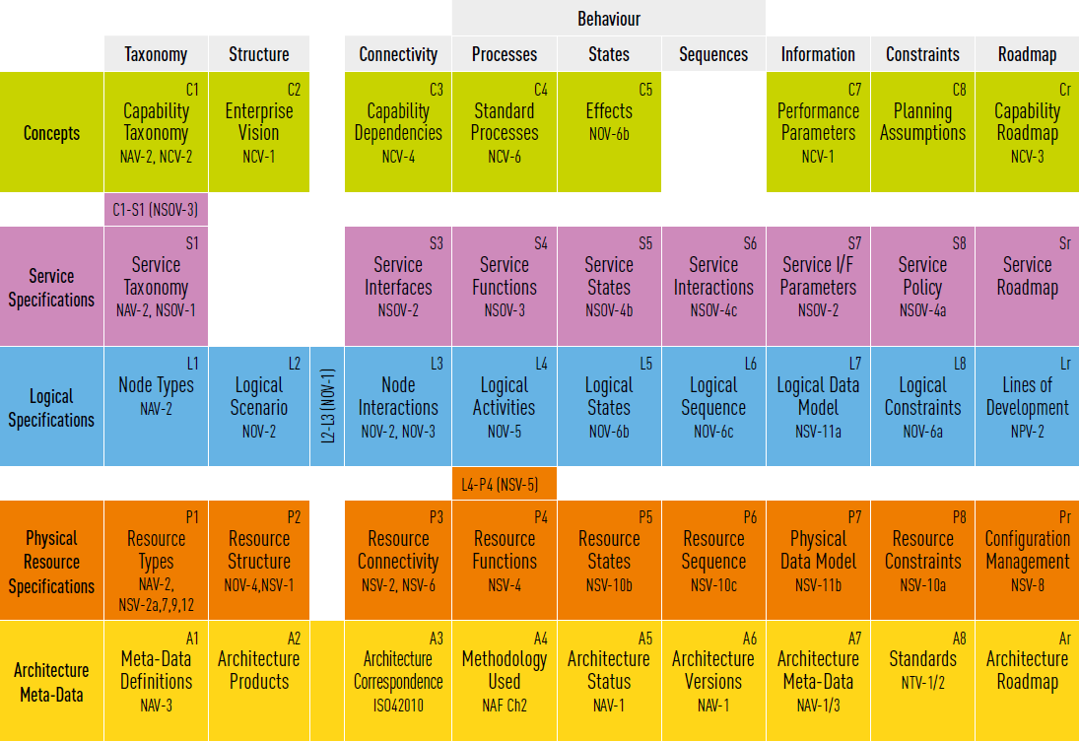
Notes:
Get spiral 5 architecture done
Distinguish between near term (CWIX) use case architecture, and long term “inside-the-lake” architecture
Conceptual and Logical specifications/views will be useful if done in different versions, for near term, spiral 5, and future

Slide 17
Long Term NCDF Data Lake Architecture issues
In addition to supporting annual CWIX Experimentation, the Architecture TT also has a duty to support exploration of architecture concerns, based on a longer view (i.e., Post – FMN Sp5) of the NCDF Data Lake goals
To this end, decisions regarding federated architecture, federated search, development and refinement of an NCDF SRM, other concerns, are consider while developing the annual experimental architecture and supporting products
Question for DM CaT – What are some of the Long Term Conditions that the TT should be considerate of?
Federated Architecture
Publish/Subscribe
Decomposition of Data Lake services
Data Lake Transformation Services
Data Lake Archival Capabilities

Slide 18
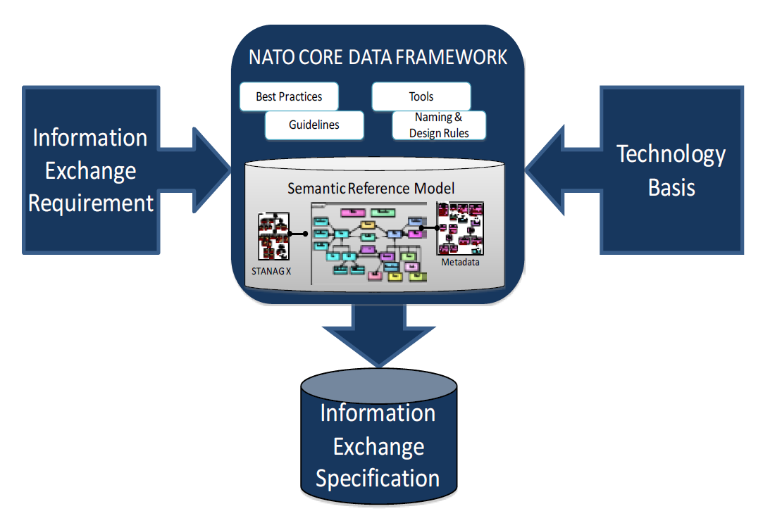
Architecture TT Efforts remain in support of (1) NCDF Framework
Improve decision making by establishing a semantic reference within a framework that cuts across existing COIs and data stovepipes

Slide 19
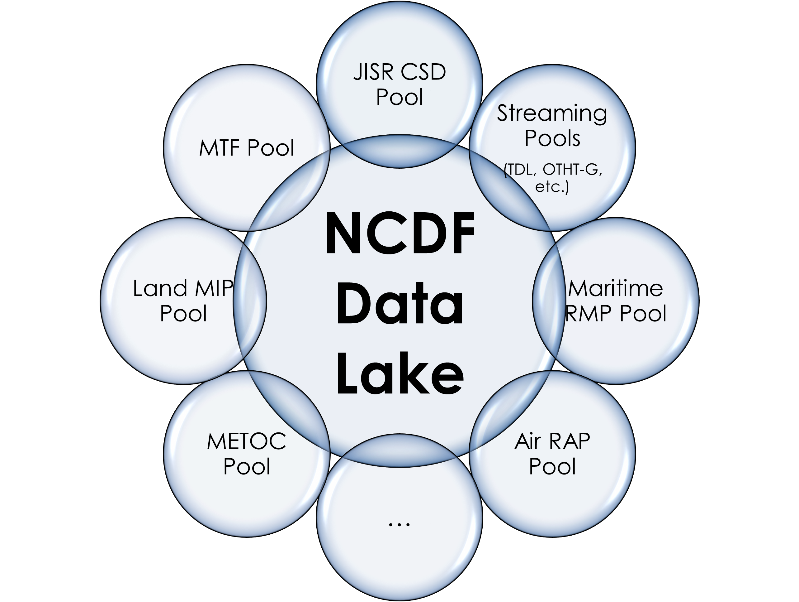
Architecture TT Efforts remain in support of (2) NCDF Data Lake
Cross-Community Communications, enabled by the NCDF Framework

Slide 20
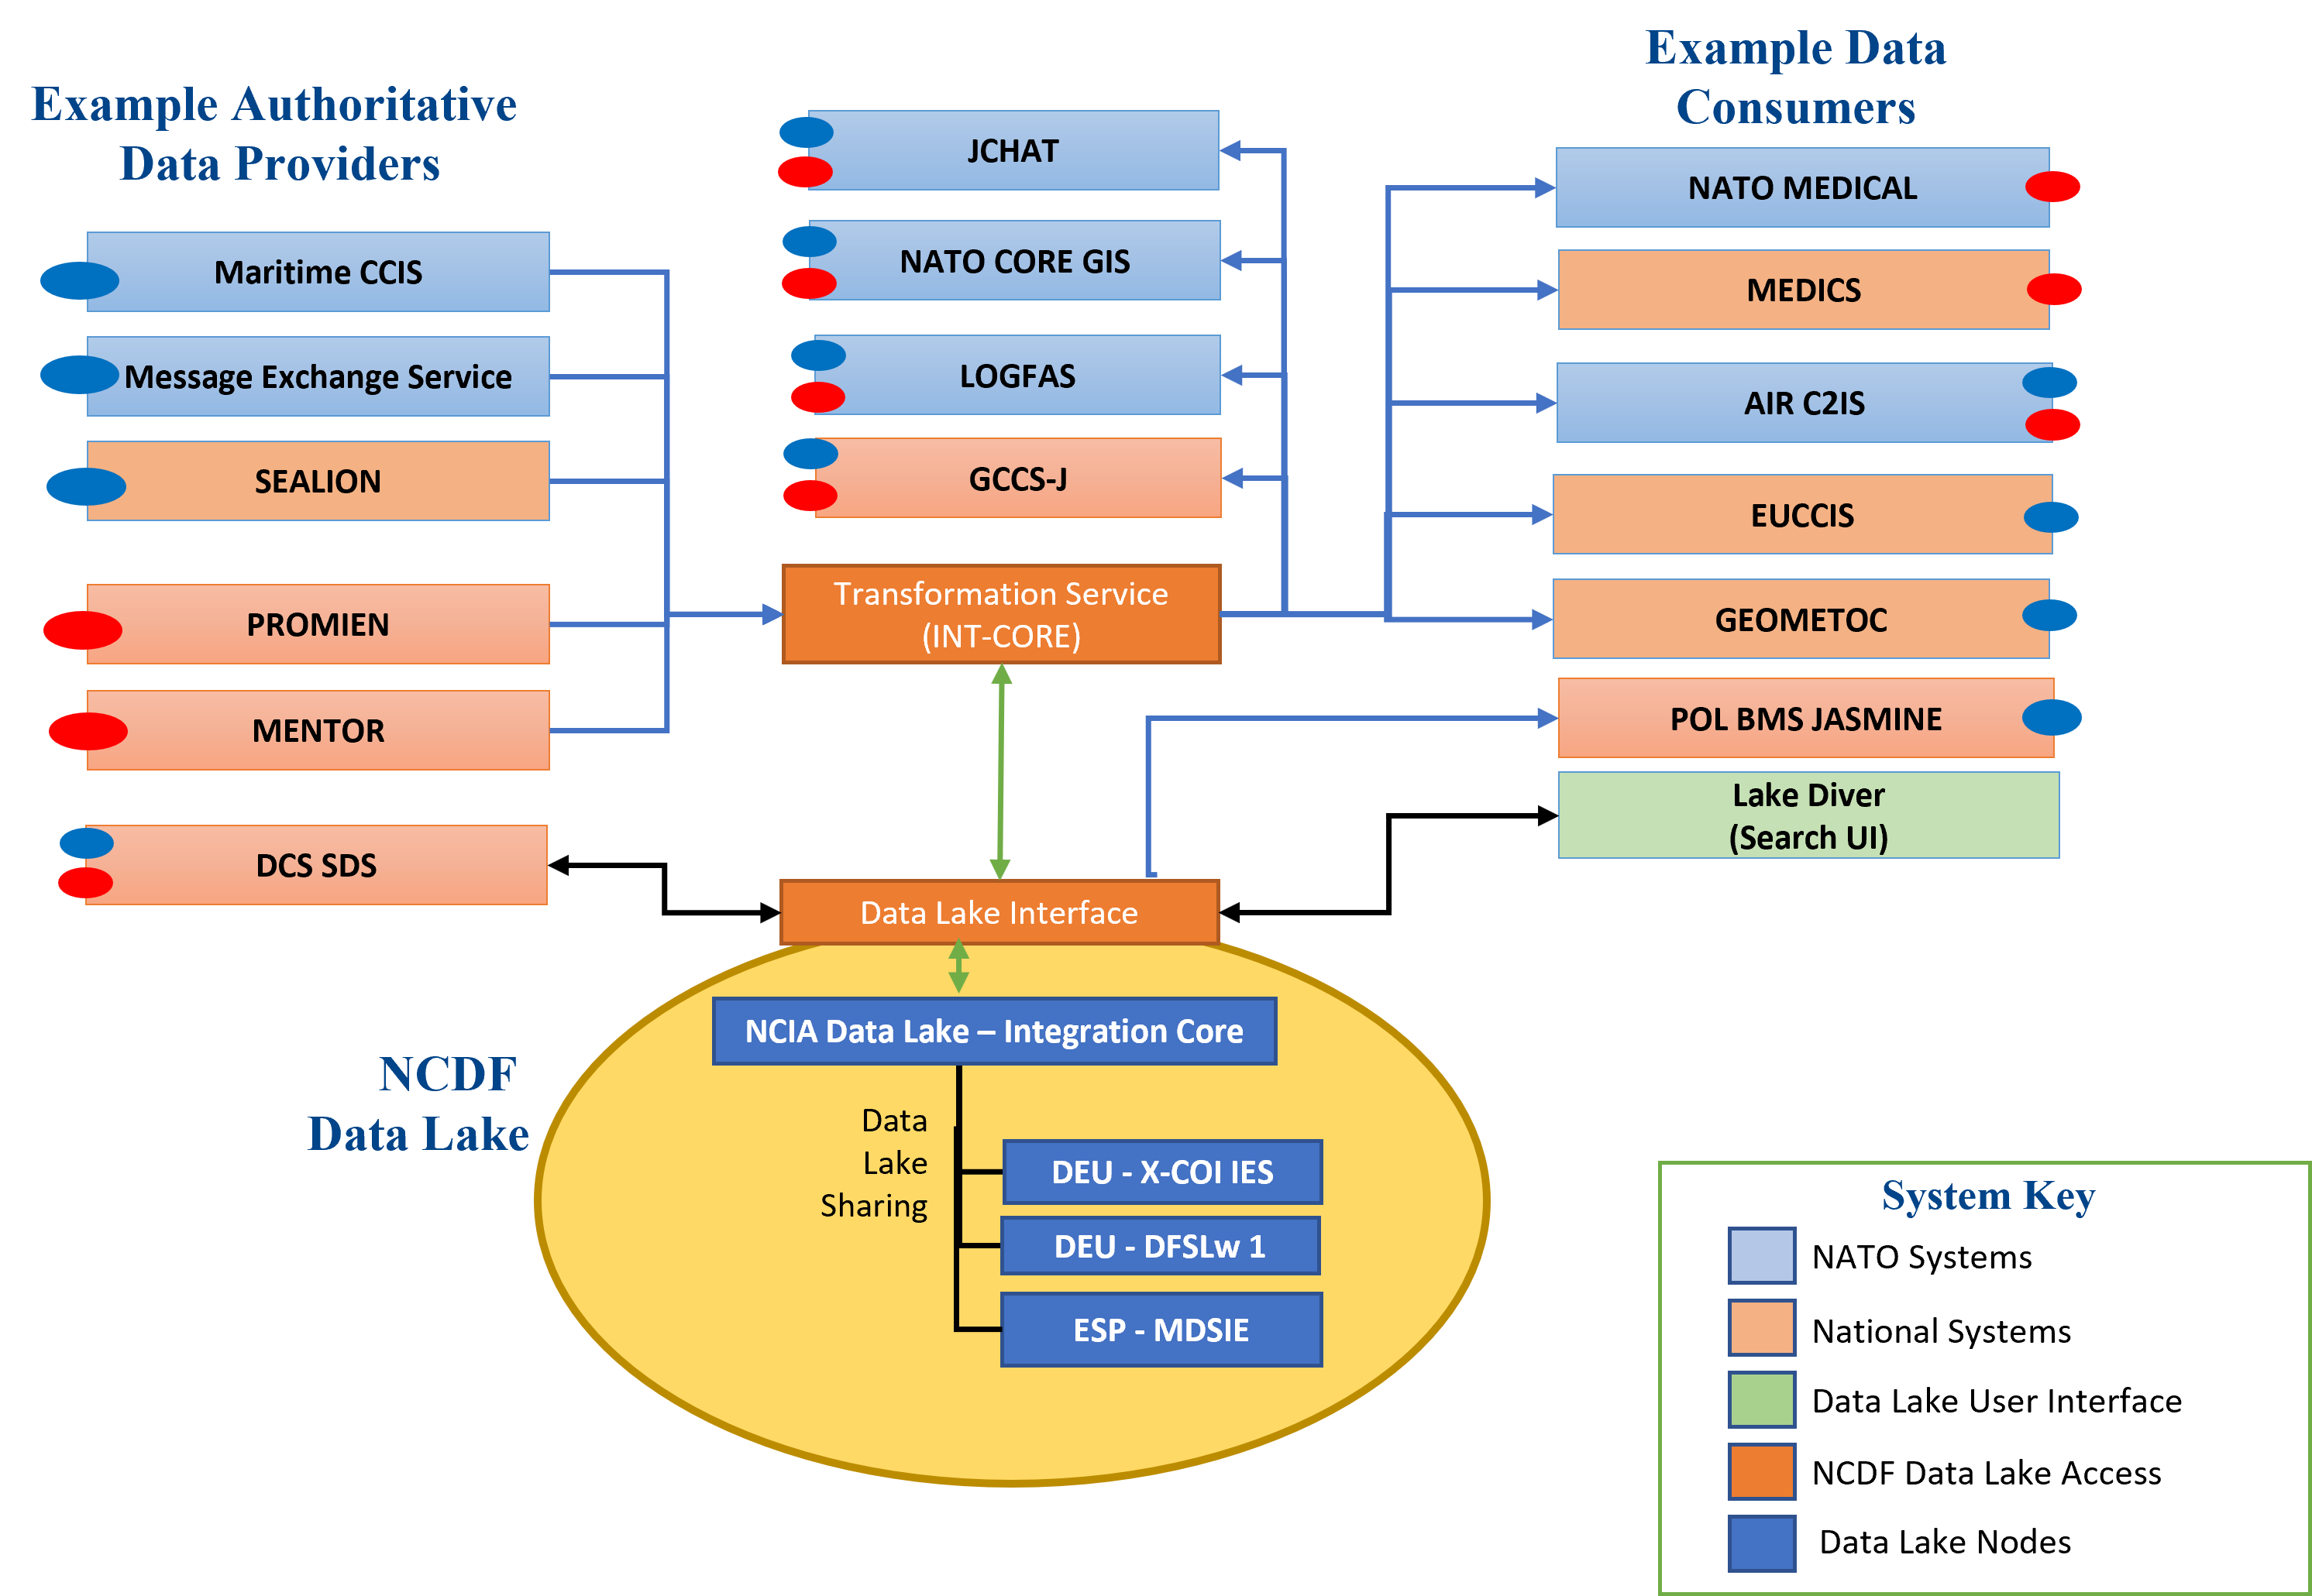
NCDF Conceptual Architecture
Maritime Use Case
CBRN Use Case
As of CWIX 2022

Slide 21
NATO and NCDF Semantic Reference Model (SRM) Statement
A single, comprehensive SRM for all NATO semantics is doomed to failure and is not a viable option
A dynamic environment that includes semantics from multiple SRMs is needed—this will be hard, but necessary
The NATO/NCDF SRM effort will be separate from MIM/STANAG 5643
Intent is that STANAG 5643 moves forward, independent from work here
A NATO/NCDF semantic environment will include a subset of MIM semantics, and likely form the initial set of NCDF semantics
A goal of the NCDF semantic environment is to facilitate cross-Community exchanges
Interchange can be supported by using atomic concepts, mapped to semantic meaning of data from different communities
Community SRMs will be independently governed by each Community
Community SRMs are independent, and those communities will manage their SRMs as they desire/require (Proposed)
Format of an SRM – No requirement for a community to represent its SRM using any technology or format
Every SRM should provide schema for its exchanges
The harmonized semantics across the Communities represents the universal intersection that interoperability can rely on
A NATO/NCDF semantic environment will be governed by NATO
Models and standards may be managed elsewhere, but when they are brought into the NATO semantic environment, NATO will govern their inclusion.
Changes to SRMs will require that NATO be aware of them, and handled, within the semantic environment.
The Core SRM (and associated interoperability mechanisms) need to be exposed and accessible as at least one technical artifact(Proposed)
There needs to be a link between Core SRM and any Community SRM, that needs to be based on a defined set of overlapped semantics (Proposed)
These statements are a distillation of remarks made during DM CaT and Syndicate meetings and amplified by discussion at CWIX 2022 and during special SRM sessions of the NCDF Data Lake Architecture Tiger Team.
Proposed Statements to be approved by DM-CaT/
Notes:
Sept 16 – We need a statement about what the higher level Semantic Fabric (Lanzo) is, and how it is working for the DataLake and mappings to community SRMs
Maybe a statement before the last two Proposed statements that defines a Semantic Fabric…
AN independent evolution of individual COI models will occur… if there is a NATO or NCDF SRM, then COIs should start with that as a core, and extend it throughout as needed… (comment from Nico)
In order to support Interoperability, we require a common language. If we are going to have interoperability, then …
Purpose – The DM CaT directed the DataLake Tiger Team to investigate and discuss Multiple SRM situations…
Nico – The slide should more clearly state that we are focused on a single harmonized solution…
Work in Progress
Phil – adding a purpose
Sept 6
Comment on second proposed statement – move away from statement specifically on XML schema – be more general (RDF triples, etc)
Fahri – Need a distinct answer to (1) we have an information model, and when we talk about NATO SRM and MIM, they are different entities, (2) clearly state if NATO SRM and NCDF SRM are different entities, (3) if NATO SRM is information is it at conceptual level or logical level
Sept 30 – Draft MOA and New Vision Paper, others have named the NCDF Core SRM as the “Common Cross-COI SRM”
Oct 4 – Fabian – third proposal – “The core-semantics used in the CoI SRM must be mapped/linked to the respective semantics in the Core SRM”
Woody – “...CXCSRM will represent a common language required to enable cross-community information exchanges: While concepts relevant to more than just one domain need to be harmonized and become elements of the CXCSRM, existing domain specific semantic reference models and resources will continue to serve their purpose within their domain..."

Slide 22
Architecture directions for 2023
Based on conversation, July 11 (Vincenzo, Mark, Rytis, Chuck)
Focus on Federation Architecture…
(focused on data lake services…now look at federation)
Federate Lakes (4 nodes; 5 nodes with US node next year; Germany, Spain, others?)
Federated Search (core services syndicate) (perhaps delayed until spiral 6, but might be explored here)
Multiple SRMs – MIM and a second or third model that is independent
Decomposing DataLake Services – what are the services, and who does them?
Pub/Subscribe – Explore implications and architecture possibility
Hopefully result in a specification

Slide 23
Semantic Reference Model (SRM) SubGroup
Meeting on Fridays
Any who are interested are invited
Focus on issues related to the SRM (and multiple SRM) question
Working on presentations of what an impact of multiple SRMs would have on the architecture
Currently developing a slide showing the various statements regarding SRM, from DM CaT and other meetings

Slide 24
SRM SubGroup Agenda (ongoing)
Definitions
SRM (NATO SRM, COI SRM, Cross-COI SRM)
Vocabularies (ontology, taxonomy, etc)
Semantic Environment
Establish requirements for an SRM
Present final (draft) version of SRM Statement
Discuss/Alter/Approve
Work In progress
Do we continue special SRM sessions?
Yes, through September

Slide 25
NATO and NCDF Semantic Reference Model (SRM) Statement
A single, comprehensive SRM for all NATO semantics is doomed to failure and is not a viable option
A dynamic environment that includes semantics from multiple SRMs is needed—this will be hard, but necessary
The NATO/NCDF SRM effort will be separate from MIM/STANAG 5643
Intent is that STANAG 5643 moves forward, independent from work here
A NATO semantic environment will include a subset of MIM semantics, and likely form the initial set of NATO semantics
A goal of the NATO semantic environment is to facilitate cross-COI exchanges
Interchange can be supported by using atomic concepts, mapped to semantic meaning of data from different communities
COI SRMs will be independently governed by each COI
Format of an SRM – No requirement for a community to represent its SRM using any particular technology or format
Every SRM should provide schema for its exchanges
The harmonized semantics across the COIs represents the universal intersection that interoperability can rely on
A NATO semantic environment will be governed by NATO
Models and standards may be managed elsewhere, but when they are brought into the NATO semantic environment, NATO will govern their inclusion.
Changes to SRMs will require that NATO be aware of them, and handled, within the semantic environment.
(proposed) Community SRMs are independent, and can manage themselves as they desire/require
(proposed) The Core SRM (and associated interoperability mechanisms) need to be exposed and accessible via XML schema
(proposed) There needs to be a link between Core SRM and any COI SRM, that needs to be based on overlapped semantics
These statements are a distillation of remarks made during DM CaT and Syndicate meetings and amplified by discussion at CWIX 2022 and during special SRM sessions of the NCDF Data Lake Architecture Tiger Team.
Notes:
Sept 16 – We need a statement about what the higher level Semantic Fabric (Lanzo) is, and how it is working for the DataLake and mappings to community SRMs
Maybe a statement before the last two Proposed statements that defines a Semantic Fabric…
AN independent evolution of individual COI models will occur… if there is a NATO or NCDF SRM, then COIs should start with that as a core, and extend it throughout as needed… (comment from Nico)
In order to support Interoperability, we require a common language. If we are going to have interoperability, then …
Purpose – The DM CaT directed the DataLake Tiger Team to investigate and discuss Multiple SRM situations…
Nico – The slide should more clearly state that we are focused on a single harmonized solution…
Work in Progress
Phil – adding a purpose
Sept 6
Comment on second proposed statement – move away from statement specifically on XML schema – be more general (RDF triples, etc)
Fahri – Need a distinct answer to (1) we have an information model, and when we talk about NATO SRM and MIM, they are different entities, (2) clearly state if NATO SRM and NCDF SRM are different entities, (3) if NATO SRM is information is it at conceptual level or logical level

Slide 26
Upcoming DM-CaT
Materials to present at upcoming DM CaT
Progress made in SRM SubGroup
Architecture plans for this year
Evolution of CWIX22 Architecture Artifacts to CWIX23
Add more to the tempo for development

Slide 27
Agenda
Discuss DM-CaT results and findings re: Data Lake Architecture.
Discuss tempo of Architecture TT going forward
Architecture directions for 2023
Notes:
Quite an environment for external services
(such as search UI)
Focus on Federation – search etc. – postpone talk on archival service
Focus on Federation Architecture…
(focused on data lake services…now look at federation)
Federate Lakes (4 nodes; 5 nodes with US node next year)
Federated Search (core services syndicate) (perhaps delayed until spiral 6, but might be explored here)
Multiple SRMs – MIM and a second or third model that is independent
Decomposing DataLake Services – what are the services, and who does them?

Slide 28
Attendees July 26
Rytis
Phil
Mark Dotson
Myself

Slide 29
DM-CaT results
Presented Architecture TT work
Received request to begin regular issue/action item tracking (see chart in this slide deck)
2023 will focus on finishing Spiral 5
Major new initiatives that may impact Architecture for 2023
Federated Data Lake Nodes (including new US/J6 node)
Multiple SRMs
Federated Search
DCS (Data Centric Security)

Slide 30
Agenda Item: Architecture directions for 2023
Based on conversation, July 11 (Vincenzo, Mark, Rytis, Chuck)
Focus on Federation Architecture…
(focused on data lake services…now look at federation)
Federate Lakes (4 nodes; 5 nodes with US node next year)
Federated Search (core services syndicate) (perhaps delayed until spiral 6, but might be explored here)
Multiple SRMs – MIM and a second or third model that is independent
Decomposing DataLake Services – what are the services, and who does them?
Pub/Subscribe – Explore implications and architecture possibility
Hopefully result in a specification

Slide 31
Action Items
Open Date | Assignee | Topic | Status | Close Date
22/07/12 | Team | Archiving | Open
22/07/12 | Team | NCDF Data Identifier | Open
22/07/12 | Team | Federated Search | Open
22/07/12 | Team | Open Search/Elastic Search | Open

Slide 32
Agenda
Discuss CWIX 2022 results and findings re: Data Lake Architecture.
Discuss open issues left over from last year (the meetings leading up to CWIX 2022)
Architecture directions for 2023
Discuss agenda items for upcoming DM CaT (especially possible topics that may lead to the upcoming year's developments re: Data Lake.
Notes:
Quite an environment for external services
(such as search UI)
Focus on Federation – search etc. – postpone talk on archival service
Focus on Federation Architecture…
(focused on data lake services…now look at federation)
Federate Lakes (4 nodes; 5 nodes with US node next year)
Federated Search (core services syndicate) (perhaps delayed until spiral 6, but might be explored here)
Multiple SRMs – MIM and a second or third model that is independent
Decomposing DataLake Services – what are the services, and who does them?

Slide 33
Attendees
Rytis
Phil
Vincenzo
Mark Dotson
Myself

Slide 34
Agenda Item 1: Discuss CWIX 2022 results and findings re: Data Lake.
NCDF Data Lake Goals for CWIX 2022
Verify FMN Spiral 5 Service Instructions for Cross-Community of Interest Information Sharing
Test search and retrieval patterns
Test ability of NCDF Data Lake to handle different data types, formats, protocols
Experiment with security, search, and discovery metadata
Explore how cross COI information sharing enhances decision-making
Introduce/experiment with Data Lake user interface (Lake Diver)
Partners
Focus Areas (11): AIR, Data Centric Security (DCS), Future Core Services (FCS), GEO-METOC, JISR, LAND, LOGMED, Maritime, Modeling & Simulation, Multi-Lateral Interoperability Programmer (MIP), OPCMD
Nations (11): CAN, DEU, EU, FIN, NATO, NLD, NOR, POL, ROU, TUR, US
Content: JISR/SA, Medical (e.g. disease reports, planning, MTF status, decontamination), Geospatial (e.g. hazard predictions), BSOs/tracks, force protection, LOG (e.g. facilities, consumable reports, transportation alerts, exclusion zones), CBRN, ACO, ATO, free text (dynamic chat), air bases, white shipping
Data formats: Coalition Shared Database (JISR), CSV, KML, Link-16, MIP, ADatP-3, MTF, NCDF, NVG, OTH-G, native XML, XMPP, unstructured data
Taken from the CWIX 2022 NCDF Data Lake AAR report by McCoy and Schultz

Slide 35
NCDF Data Lake Architecture
Example Data
Consumers
Example Authoritative
Data Providers
JCHAT
NATO MEDICAL
Maritime CCIS
NATO CORE GIS
MEDICS
Use Case 2
Message Exchange Service
LOGFAS
AIR C2IS
GCCS-J
CBRN Domain:
CBRN messages are provided in ADatP3 MTF format by national systems PROMIEN and MENTOR, in ADatP3 MTF format, and translated by the INT-CORE transformation service, for inclusion in the NCDF Data Lake.
Systems can retrieve that information from the Data Lake, in any format (including NVG overlays), through web-services, after being translated by the INT-CORE transformation service.
SEALION
EUCCIS
PROMIEN
Transformation Service (INT-CORE)
GEOMETOC
MENTOR
POL BMS JASMINE
Lake Diver
(Search UI)
DCS SDS
Data Lake Interface
NCDF
Data Lake
NCIA Data Lake – Integration Core
Data
Lake
Sharing
Use Case 1
DEU - X-COI IES
System Key
DEU - DFSLw 1
NATO Systems
Maritime Domain: NAVSITREP information in the ADatP-3 MTF Gold format will come into the NCDF Data Lake, after being transformed by the INT-CORE transformation service. Information from the NCDF Data Lake will be consumed by C2 systems retrieved and translated to COI formats by the INT-CORE transformation service.
ESP - MDSIE
National Systems
Data Lake User Interface
NCDF Data Lake Access
Data Lake Nodes
Notes:
Everything was on Pink except:
Medical
Logistics
DEU DFSLw (CC-150)
There was some ad-hoc patient tracking info moved from low-to-high via the diode. I don’t think it justifies a slide.
PROMIEN (POL): CBRN Warning & Reporting IS
SEALION (FIN): Maritime C2 system
MENTOR (TUR): CBRN planning & execution
DCS SDS (CAN): data centric security-secure data service
JASMINE BMS (POL): Battlefield Mgt System (tactical C2; Bn and below)
EUCCIS (EU): C2 system
AIR C2IS (NATO): set of Air C2 services
MEDICS (POL): medical C2

Slide 36
NCDF Data Lake Architecture
Details on how the different nodes shared information inside the data lake…
Information Flow Diagram
Illustrate how the different Nodes each implemented an instance of the API and a Data Lake
Spain accepted Post of all data from Data Lake (system 187)
German pulled all data from Data Lake (systems 110 and 152)
Use of RSQL to query your own lake, and use API to retrieve from other Data Lake Nodes
For CWIX 2023 – will follow 2022, mostly, with some room for additional exploration

Slide 37
Agenda Item 2: Discuss open issues left over from last year
High Level Items:
GUI – MVP? Work with single Data Lake, work with Federated Data Lakes
Independent – connects with API – stand alone, works with 1 instance of API
Federation (SP6?)
Archiving (exploration SP5/develop in SP6) (Does it require Specification? Etc.)
Archival services Dependent on the Delete Service
NCDF Data Identifier (timestamp, history stamp…)
Transformation Service provides V&V on Identifier
Federated Search (SP6?)
Dependent on Distributed Search
Open Search or Elastic Search (FMN – how to do open search in Federation)
Ownership/Modification Rights
Delete Service
Archival services Dependent on the Delete Service
Transformation Services
RSQL tests, as well as API tests
Security and Access Rights (DISG, etc)
Notes:
Service Instruction in Spiral 5 – distributed search… will help/inform Federated Search
Identifier – Is there a single data source per BSO?
What about multiple users reporting on single object?
What about single user reporting multiple records on single object?
Current assumption – single authoritative data source can report on and update a BSO
API Specification for Open Search or Elastic Search
Each node has its own external API implementation; do we need an API that will allow Data Lake Nodes to communicate with each other

Slide 38
Open Topic – search across nodes
Notes on Federation
Option 1 – User access Node X through the API, and then Nodes (individual Data Lake implementations) will search each other, to see if the information exists
Option 2 – User will be aware of (or API will be aware of) multiple nodes, and search will address all nodes that API is aware of

Slide 39
Agenda Item 3: Architecture directions for 2023
Based on conversation, July 11 (Vincenzo, Mark, Rytis, Chuck)
Focus on Federation Architecture…
(focused on data lake services…now look at federation)
Federate Lakes (4 nodes; 5 nodes with US node next year)
Federated Search (core services syndicate) (perhaps delayed until spiral 6, but might be explored here)
Multiple SRMs – MIM and a second or third model that is independent
Decomposing DataLake Services – what are the services, and who does them?
Pub/Subscribe – Explore implications and architecture possibility
Hopefully result in a specification

Slide 40
Candidate information for 2023
Cyber (possible)
Medical (possible)
Space?

Slide 41
Agenda Item 4: Discuss agenda items for upcoming DM CaT
Initial Ideas (not final) -
Describe Architect TT actions leading up to CWIX 2022
Present Architecture artifacts for CWIX 2023
Describe Architecture open issues?
Distinction between “To Be” Architecture, and “As Is” CWIX Architecture

Slide 42
End of TT meeting, July 12

Slide 43
Action Items
Open Date | Assignee | Topic | Status | Close Date
22/07/12 | Team | Archiving | Open
22/07/12 | Team | NCDF Data Identifier | Open
22/07/12 | Team | Federated Search | Open
22/07/12 | Team | Open Search/Elastic Search | Open

